Slide 1
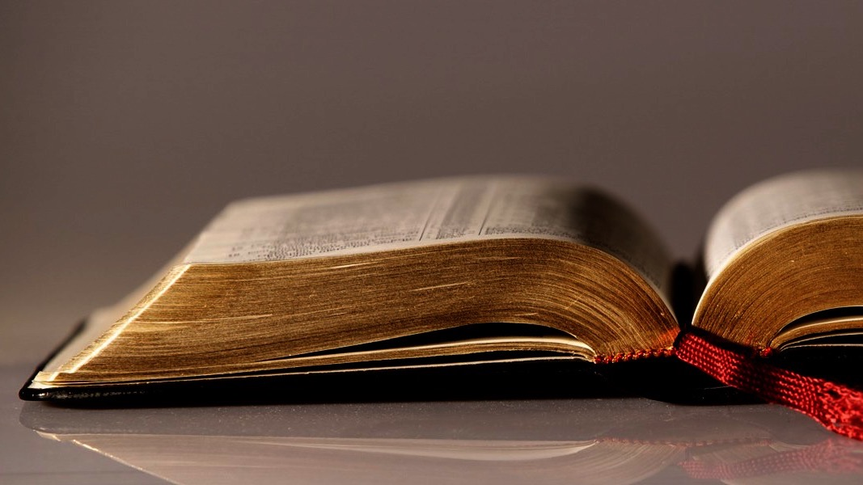
Welcome to
Our Sunday School
We’ll start at 9:07
visit OurSundaySchool.com for more about our class

Slide 2
Philemon, week 11 (pages 31–35)

Slide 3
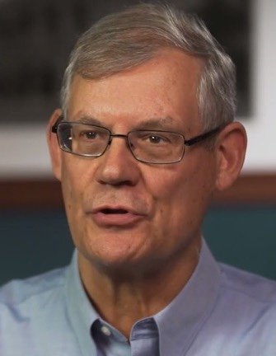
Dr. Douglas J. Moo
The fellowship that is created among those who have faith in Christ (v. 6) brings with it obligations to one another

Slide 4
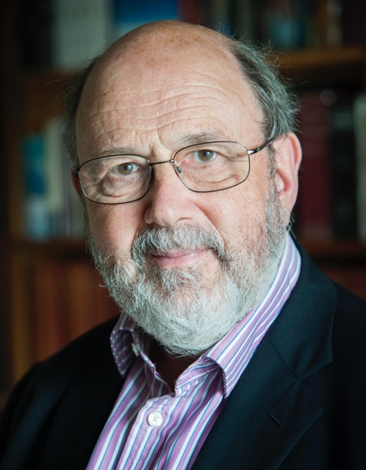
Dr. N. T. Wright
[Here is] the radical application of the doctrine of justification to everyday living. No Christian has a right to refuse a welcome to one whom God has welcomed.

Slide 5
Dr. N. T. Wright
Faith in Christ, the basis of justification, is the basis also of koinonia. Justification by faith must result in fellowship by faith.

Slide 6
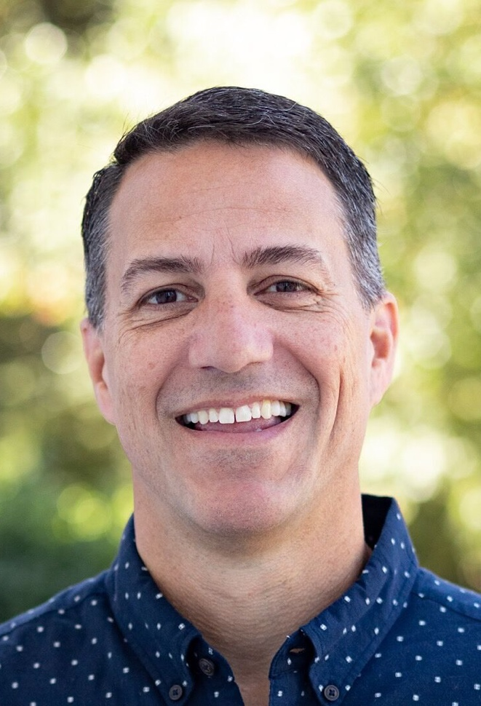
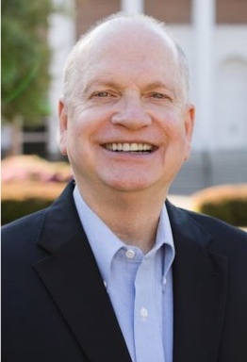
Dr. R. Scott Pace
& Dr. Daniel L. Akin
All of us who live under the lordship of King Jesus must never forget who we once were. All of us were once like Onesimus,

Slide 7
Dr. R. Scott Pace
& Dr. Daniel L. Akin
runaway slaves (sinners) from our rightful owner (God). But someone stepped in on our behalf, pled our cases, and even offered to pay our debts.

Slide 8
Dr. R. Scott Pace
& Dr. Daniel L. Akin
Those who have been reconciled to God through Christ (2 Cor 5:20-21) should be ever ready to do the same for others who have offended or wounded them.

Slide 9
Dr. R. Scott Pace
& Dr. Daniel L. Akin
It may initially sting, but joy will surely follow…. We must never forget this: we will never forgive anyone as much as God in Christ has already forgiven us.

Slide 10
Philemon 1:21–22
Since I am confident of your obedience, I am writing to you, knowing that you will do even more than I say. Meanwhile, also prepare a guest room for me, since I hope that through your prayers I will be restored to you.

Slide 11
Philemon, week 11 (pages 31–35)

Slide 12
Dr. Douglas J. Moo
Perhaps it is better to think of this obedience as directed not to Paul personally but to what we might call the “gospel imperative.”

Slide 13
Philemon, week 11 (pages 31–35)

Slide 14
3 John 4
I have no greater joy than this:
to hear that my children are walking in truth.

Slide 15
Philemon, week 11 (pages 31–35)

Slide 16
Acts 28:23
After arranging a day with him, many came to him at his lodging. From dawn to dusk he expounded and testified about the kingdom of God. He tried to persuade them about Jesus from both the Law of Moses and the Prophets.

Slide 17
Philemon, week 11 (pages 31–35)

Slide 18
Dr. R. Scott Pace
& Dr. Daniel L. Akin
Paul is optimistic—something all Christians should be because of Jesus’s ultimate authority

Slide 19
Philemon, week 11 (pages 31–35)

Slide 20
 | prayer | prayers
your (singular) | one person, one time | one person, many times
your (plural) | many people, one time | many people, many times

Slide 21
 | prayer | prayers
your (singular) | one person, one time | one person, many times
your (plural) | many people, one time | many people, many times

Slide 22
 | prayer | prayers
your (singular) | one person, one time | one person, many times
your (plural) | many people, one time | many people, many times

Slide 23
 | prayer | prayers
your (singular) | one person, one time | one person, many times
your (plural) | many people, one time | many people, many times

Slide 24
 | prayer | prayers
your (singular) | one person, one time | one person, many times
your (plural) | many people, one time | many people, many times

Slide 25
 | prayer | prayers
your (singular) | one person, one time | one person, many times
your (plural) | many people, one time | many people, many times

Slide 26
 | prayer | prayers
your (singular) | one person, one time | one person, many times
your (plural) | many people, one time | many people, many times

Slide 27
Dr. R. Scott Pace
& Dr. Daniel L. Akin
Paul understood that his fate ultimately was in the hands of God. He also believed that in the economy of God's ways, the prayers of his brothers and sisters made a difference.

Slide 28
Dr. R. Scott Pace
& Dr. Daniel L. Akin
“I hope that through your prayers”
—human responsibility
”I will be restored to you”
—divine sovereignty

Slide 29

BDAG on charizomai kkar-EID-zoh-my
to give freely as a favor
to cancel a sum of money that is owed
to show oneself gracious by forgiving wrongdoing

Slide 30
BDAG on charizomai kkar-EID-zoh-my
to give freely as a favor
to cancel a sum of money that is owed
to show oneself gracious by forgiving wrongdoing

Slide 31
Philemon, week 11 (pages 31–35)

Slide 32
Prayer time
Write down your prayer requests (on the Weekly Update or in the comments)
Lean in, engage, and pray for someone not with you
Be out of this room by 9:50
Go worship

